Slide 1
Digital Fundamentals
CHAPTER 8 Shift Registers

Slide 2
Basic Shift Register Functions
Serial in/serial out shift registers
Serial in/parallel out shift registers
Parallel in/serial out shift registers
Parallel in/parallel out shift registers
Bidirectional shift registers

Slide 3
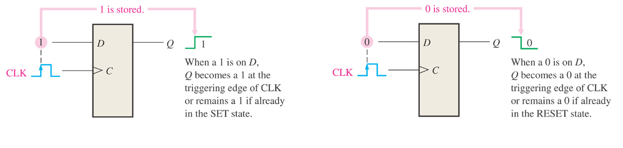
Figure 9–1 The flip-flop as a storage element.

Slide 4
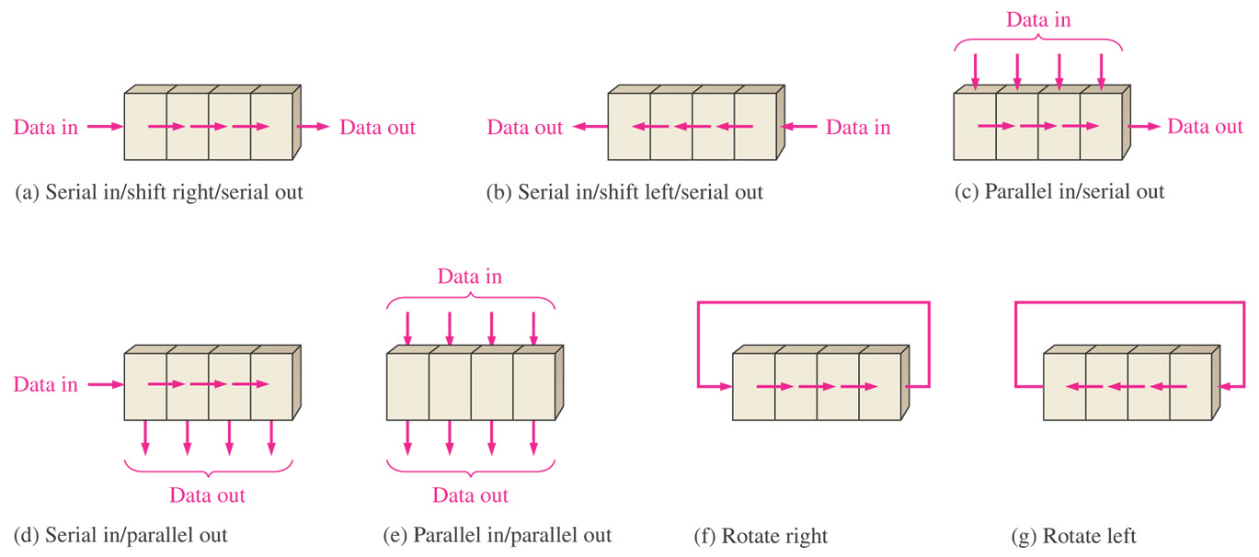
Figure 9–2 Basic data movement in shift registers. (Four bits are used for illustration. The bits move in the direction of the arrows.)

Slide 5
Serial In/Serial Out Shift Registers
4-bit version
5-bit version

Slide 6
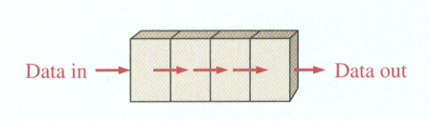
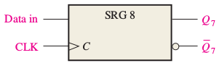
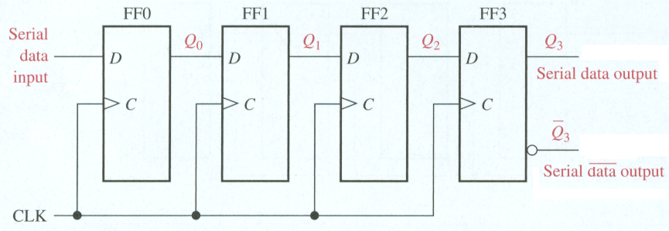
Serial In/Serial Out Shift Registers
4-bit version

Slide 7
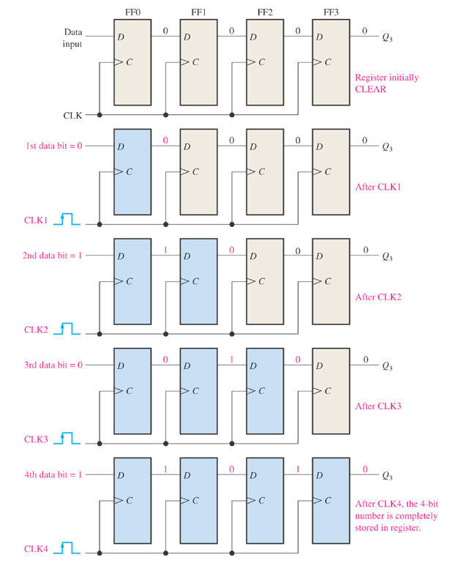
Figure 9–4 Four bits (1010) being entered serially into the register.

Slide 8
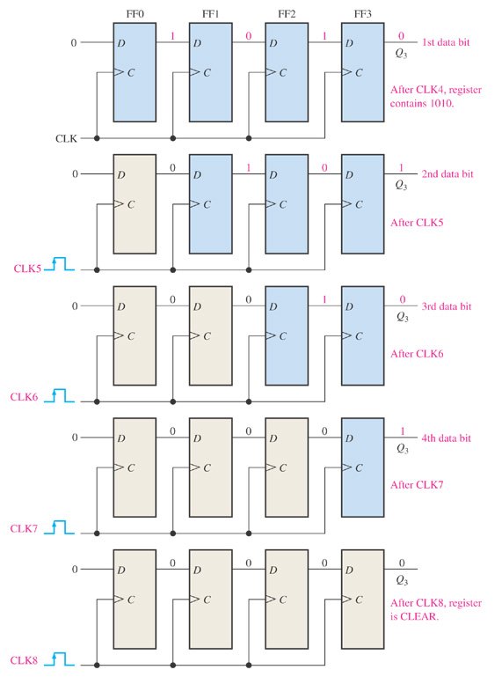
Figure 9–5 Four bits (1010) being serially shifted out of the register and replaced by all zeros.

Slide 9
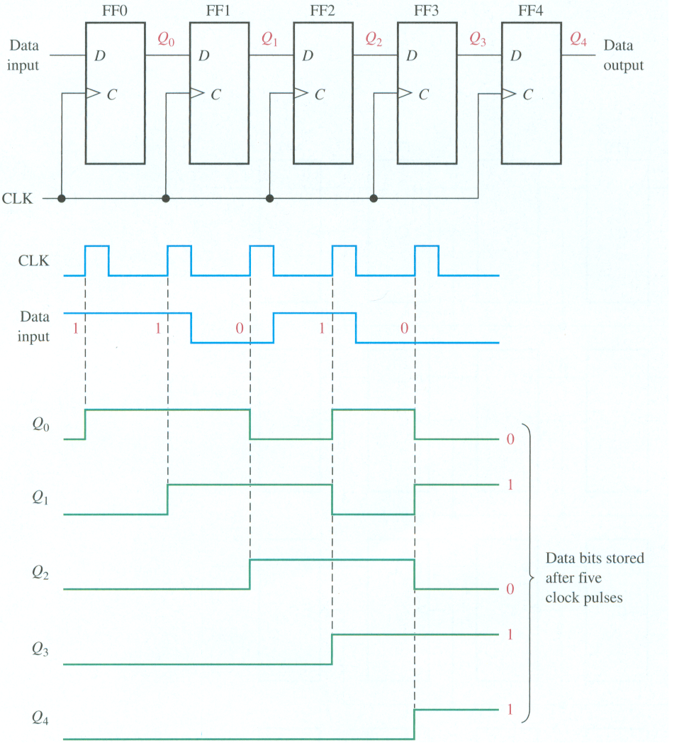

Serial In/Serial Out Shift Registers
5-bit version
Find the state of the 5-bit register after the data has been clocked in serially.

Slide 10
Serial In/Parallel Out Shift Registers
4-bit version
8-bit version

Slide 11
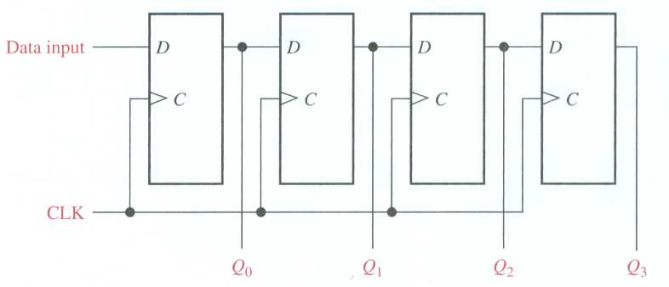
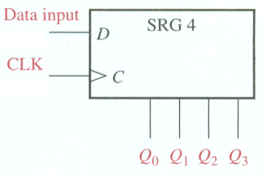
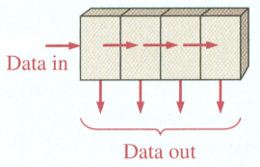
Serial In/Parallel Out Shift Registers
4-bit serial in/parallel out
SRG 4 indicates shift register with 4-bit capacity.

Slide 12
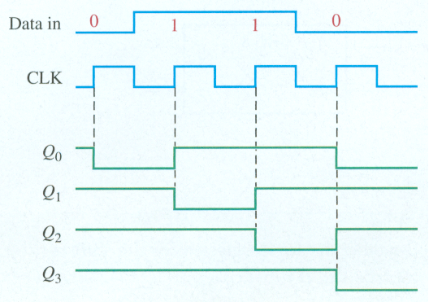
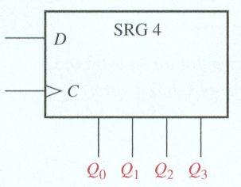
Serial In/Parallel Out Shift Registers
4-bit serial in/parallel out
Find the states of the register with the following data.
Register initially contains all 1s.

Slide 13
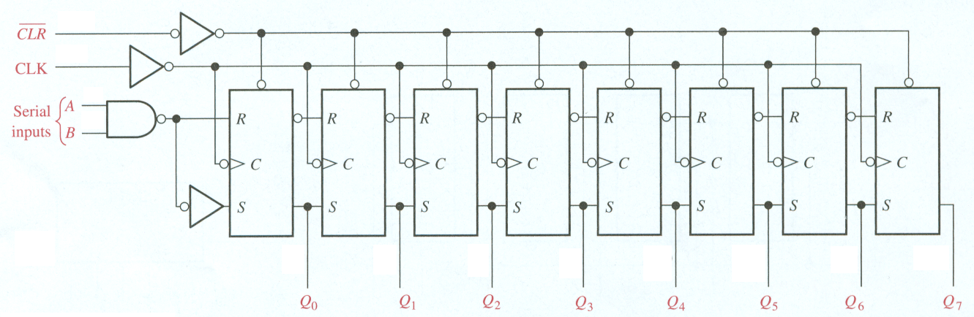
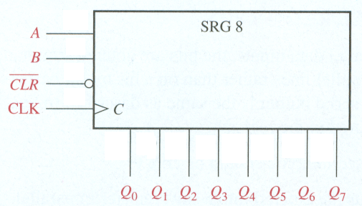
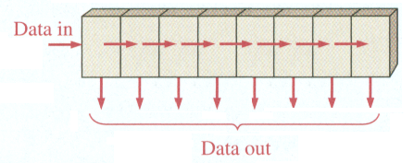
Serial In/Parallel Out Shift Registers
8-bit serial in/parallel out
A and B have to both be high to clock in a high

Slide 14
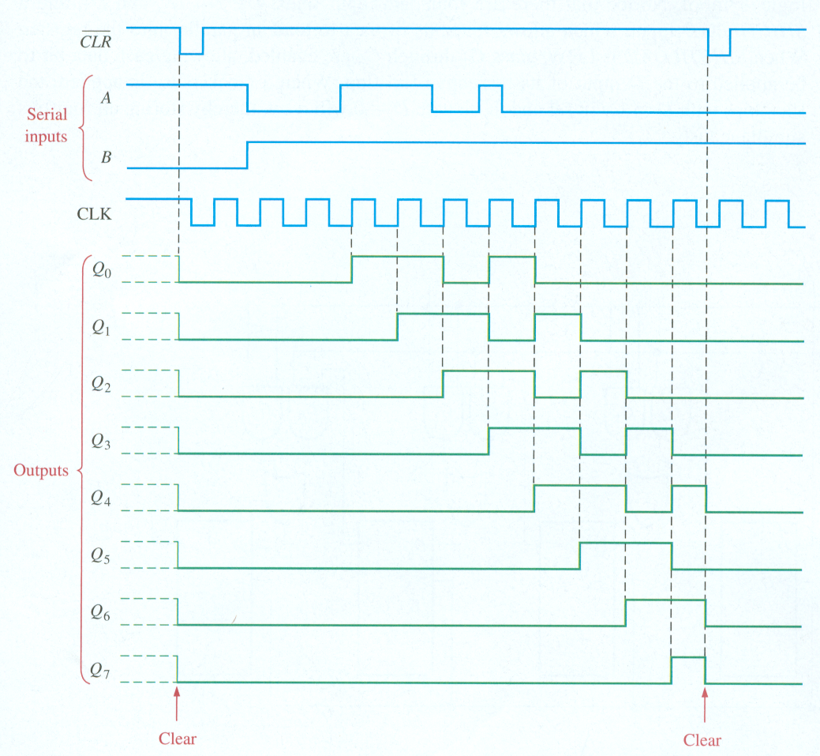
Serial In/Parallel Out Shift Registers
8-bit serial in/parallel out

Slide 15
Parallel In/Serial Out Shift Registers
4-bit version
8-bit version

Slide 16
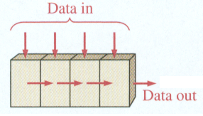
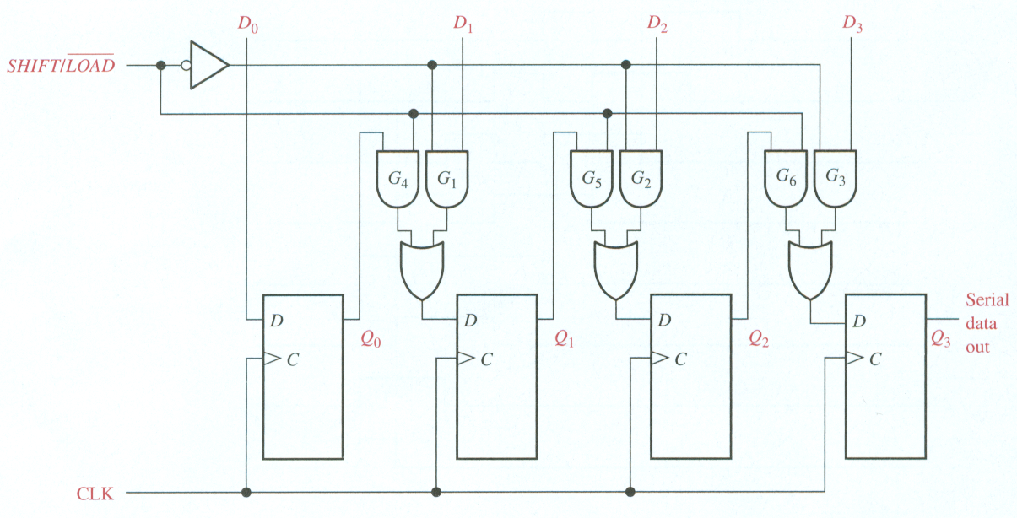
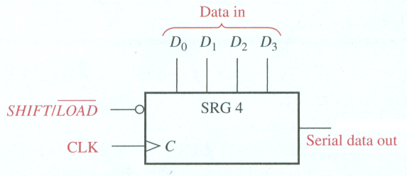
Parallel In/Serial Out Shift Registers
4-bit parallel in/serial out
When SHIFT /LOAD is LOW, gates G 1 through G 4 are enabled, allowing each data bit to be applied to the D input of its respective flip-flop.
When SHIFT /LOAD is HIGH, gates G 1 through G 4 are disabled and gates G 5 through G 7 are enabled, allowing the data bits to shift right from one stage to the next.
D₁ = Q₀ Shift/Load + Shift/Load D₁
Either shift data to the right or load the data.
When SHIFT /LOAD is LOW,
gates G 1 through G 4 are enabled, allowing each data bit to be applied to the D input of its
respective flip-flop.

Slide 17
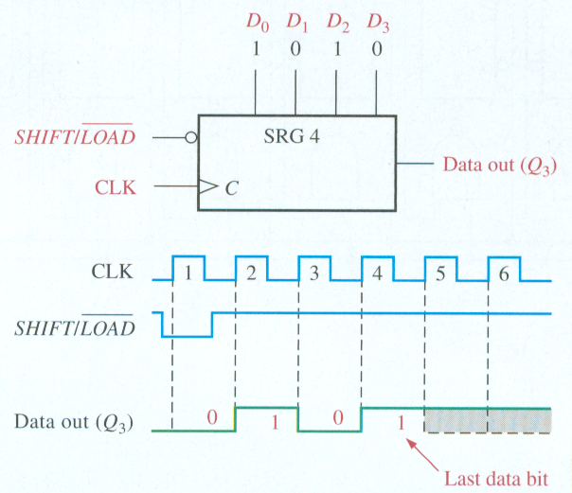
Parallel In/Serial Out Shift Registers
4-bit parallel in/serial out
Show data-output waveform with parallel input data given for D0, D1, D2, and D3.
1. data (D 0 D 1 D 2 D 3 = 1010) are loaded
2. 1 from Q 2 is shifted onto Q 3
3. 0 is shifted onto Q 3
4. last data bit (1) is shifted onto Q 3
5. all data bits have been shifted out, and only 1s remain in the register (assuming
the D 0 input remains a 1
Output will depend on if D₀ changed.

Slide 18
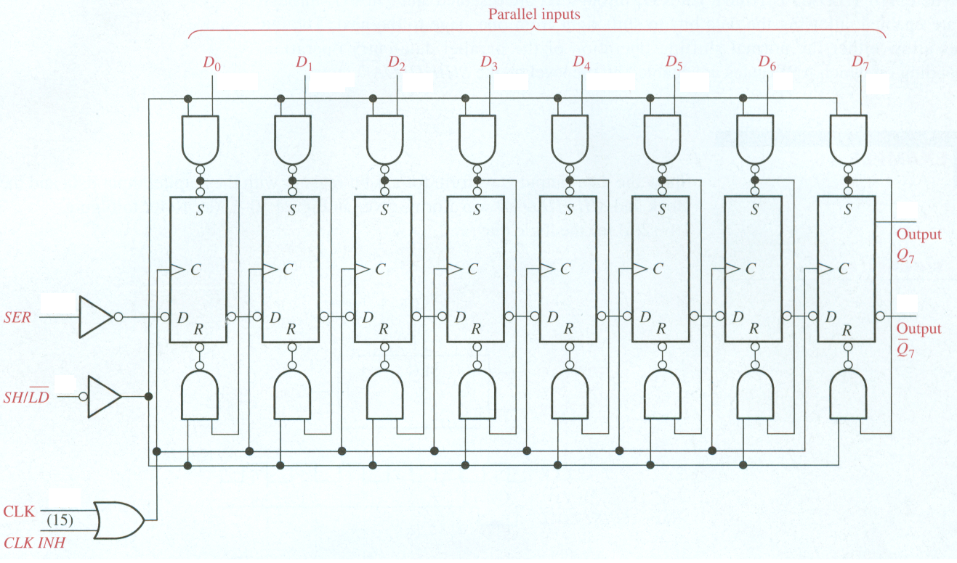
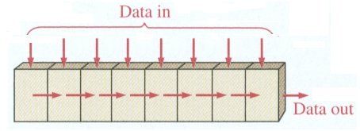
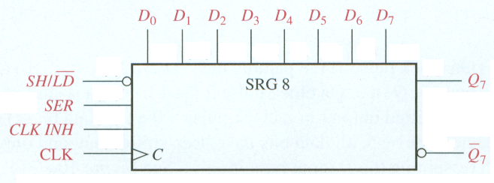
Parallel In/Serial Out Shift Registers
8-bit version
Waveforms
SER – Serial input CLK INH – Clock Inhibitor
Data at parallel inputs are loaded directly into register while shift/load is low independently of the clock or clock inhibit.

Slide 19
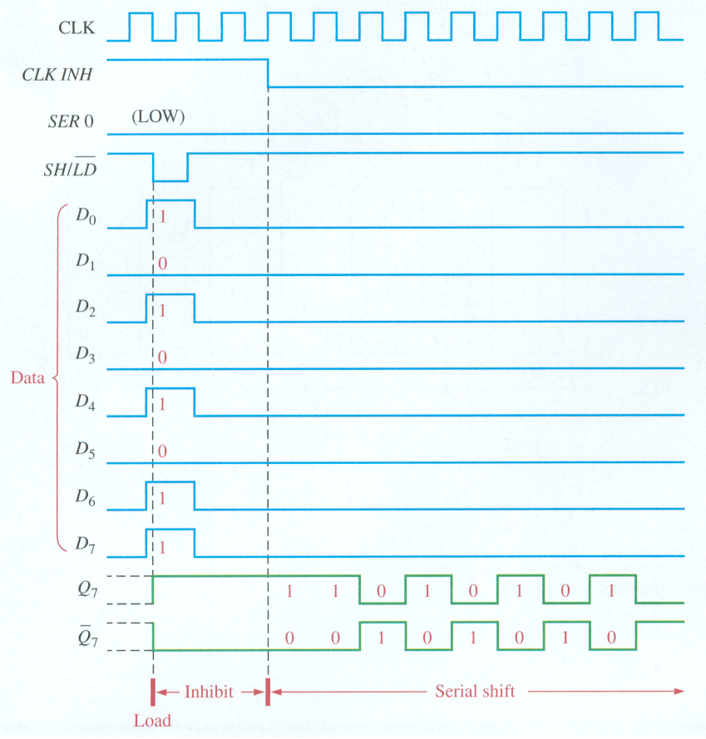
Parallel In/Serial Out Shift Registers
8-bit version

Slide 20
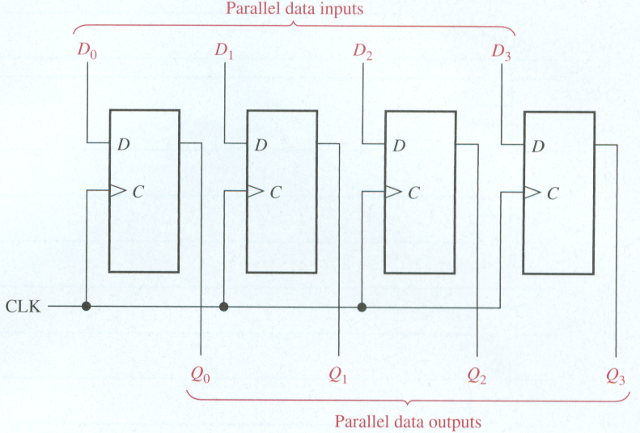
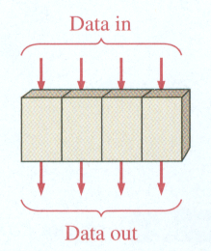
Parallel In/Parallel Out Shift Registers
4-bit version
Waveforms

Slide 21
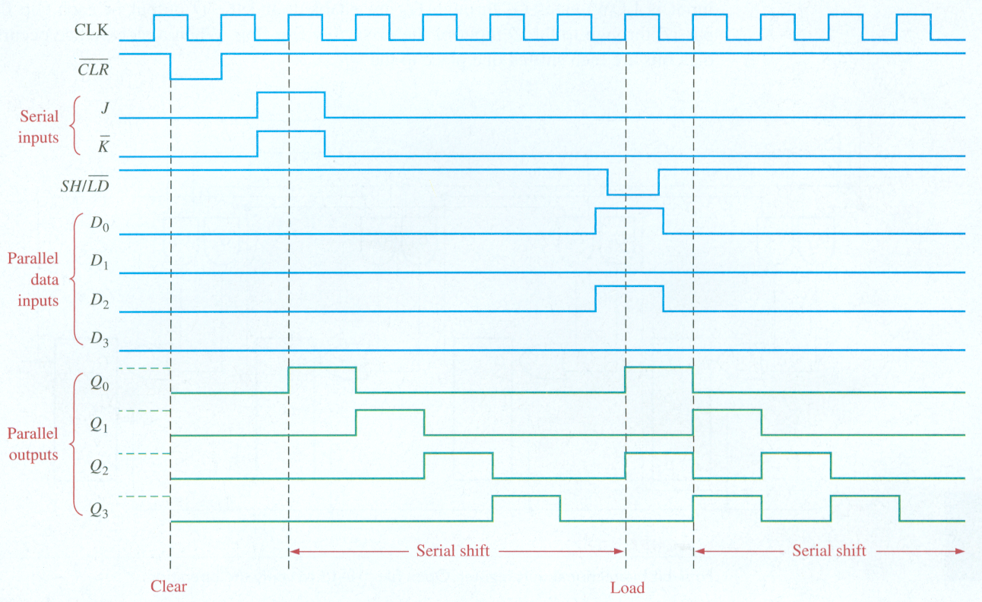
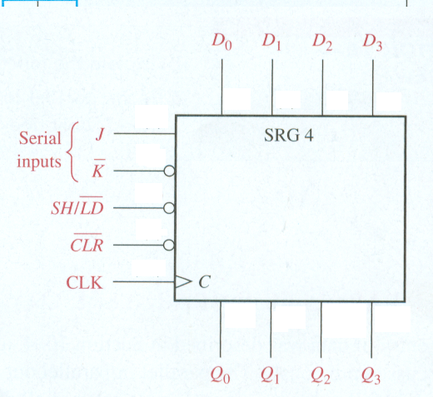
Parallel In/Parallel Out Shift Registers
4-bit version
J = 1
J = 0
K = 0
K = 1

Slide 22
Bidirectional Shift Register
4-bit serial in/serial out
4-bit universal

Slide 23
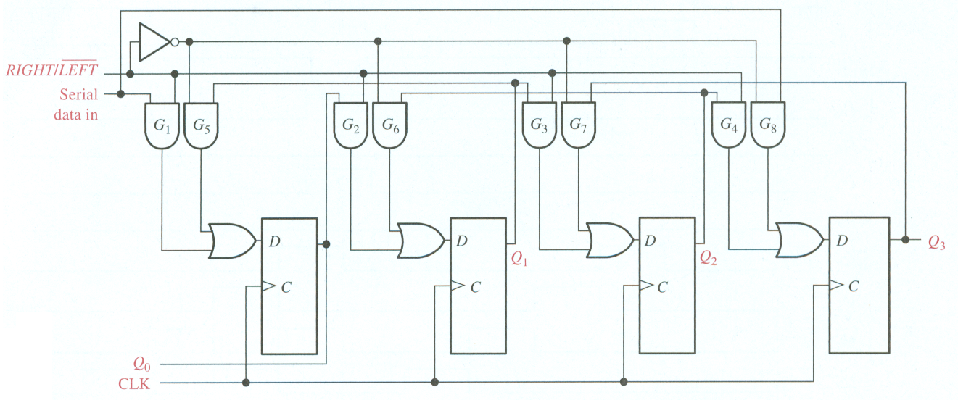
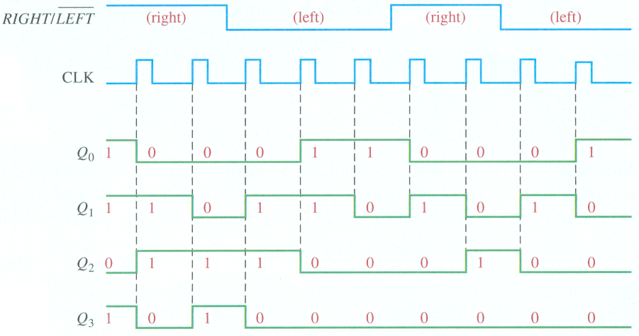
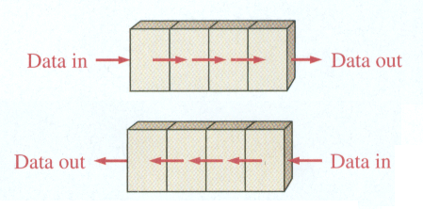
Bidirectional Shift Register
4-bit serial in/serial out
Find the output for the given RIGHT/LEFT control input. Initially, Q₀= 1,Q₁= 1,Q₂= 0,Q₃= 1. Serial data-input is LOW

Slide 24
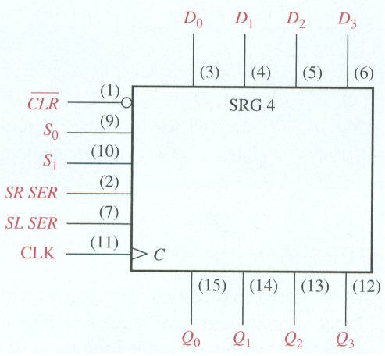
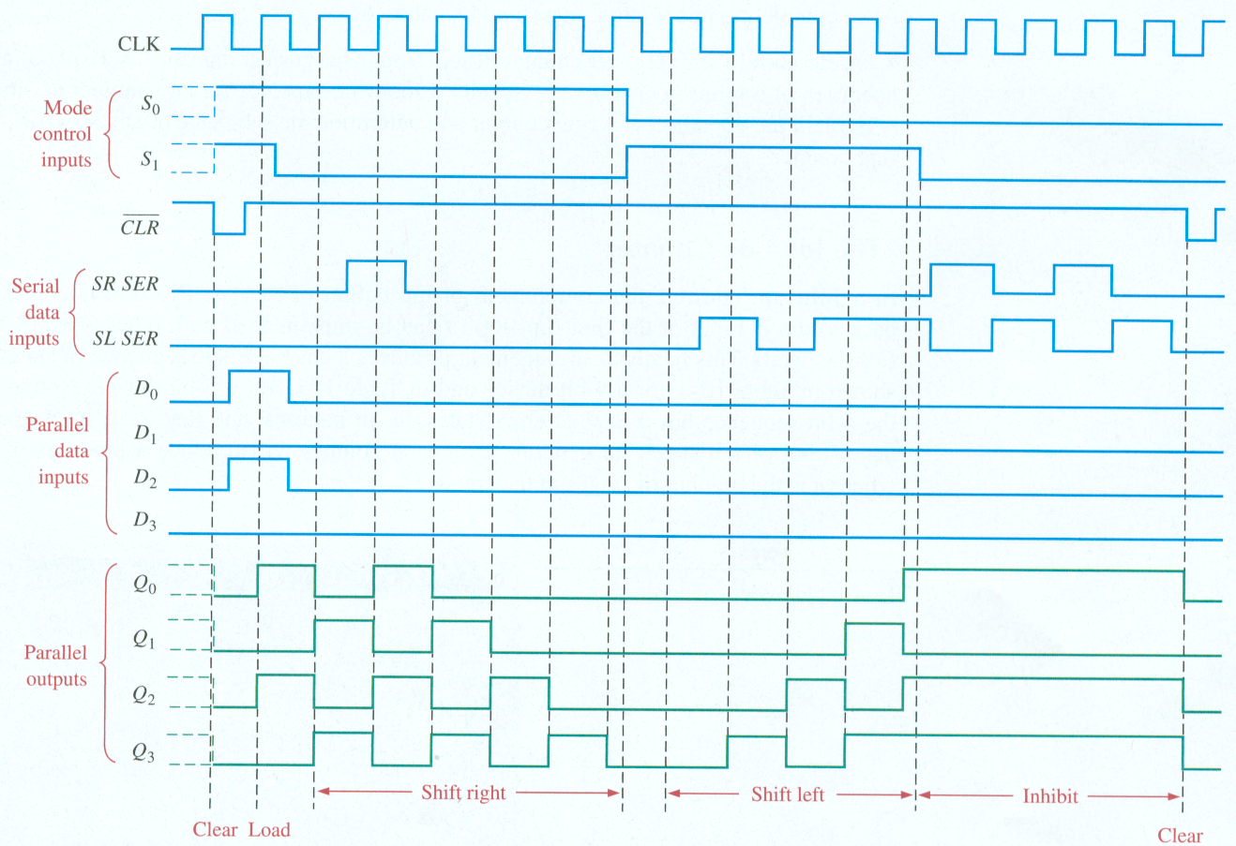
Bidirectional Shift Register
4-bit universal
S₁ S₀ Mode 1 1 Load 1 0 Shift Left 0 1 Shift Right 0 0 Inhibit

Slide 25
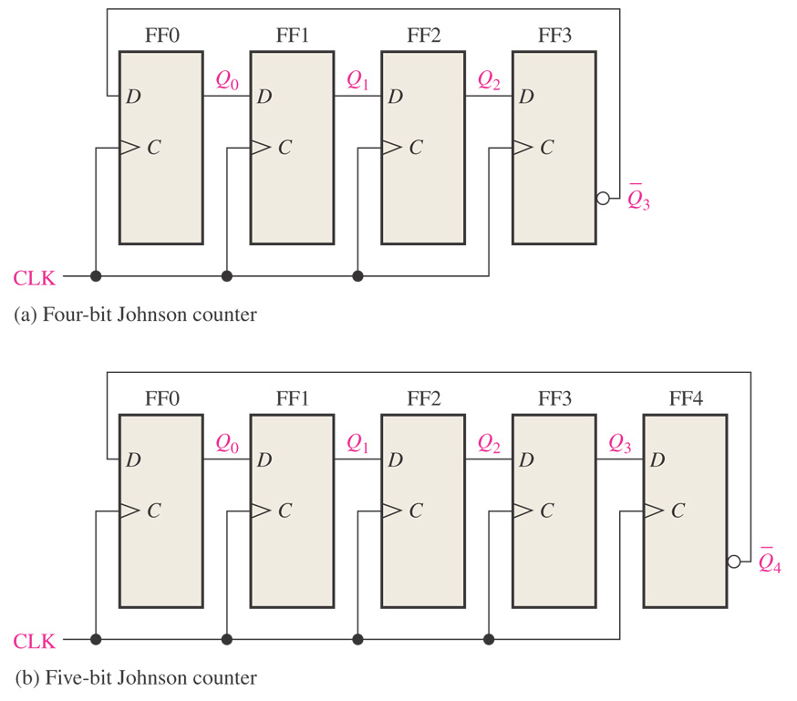
Figure 9–23 Four-bit and 5-bit Johnson counters.
Johnson counter has 2n states where n is number of flip-flops.
Clock Pulse Q0 Q1 Q2 Q3 0 0 0 0 0 1 1 0 0 0 2 1 1 0 0 3 1 1 1 0 4 1 1 1 1 5 0 1 1 1 6 0 0 1 1 7 0 0 0 1
has 8 states.
has 10 states.

Slide 26
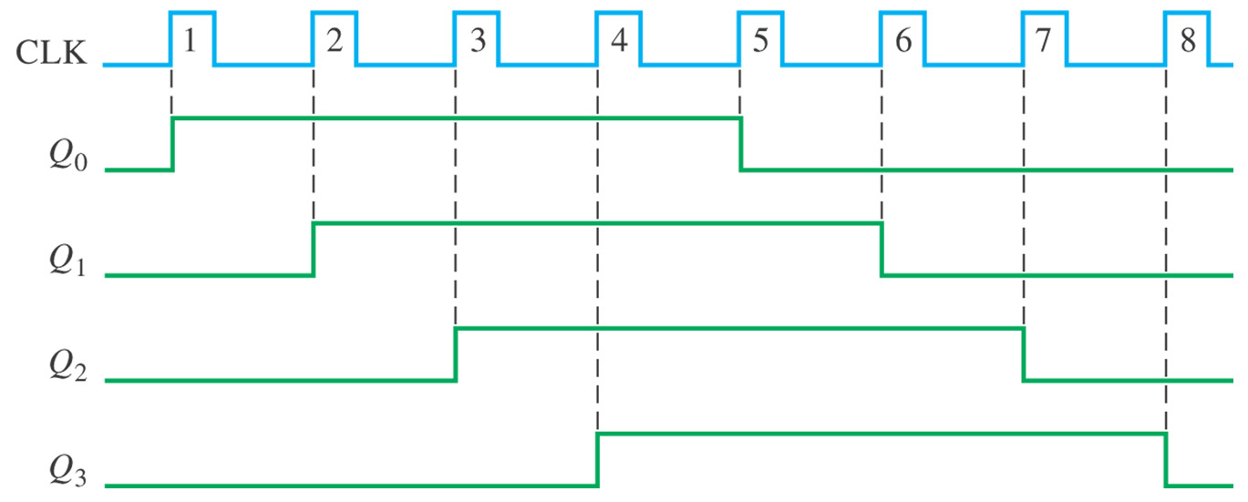
Figure 9–24 Timing sequence for a 4-bit Johnson counter.

Slide 27
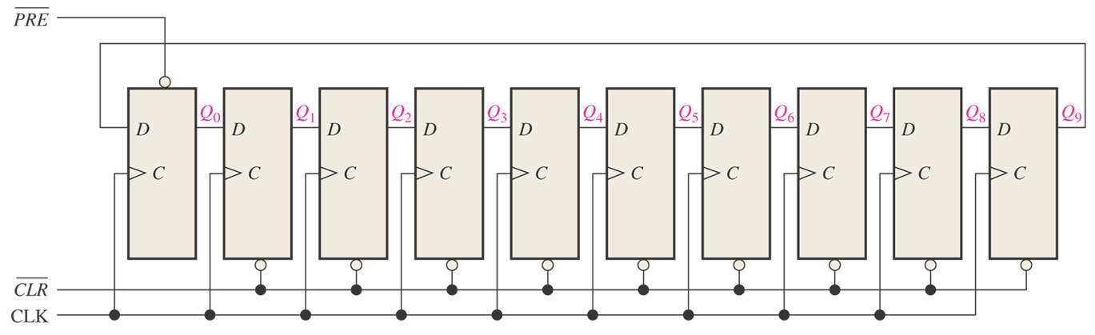
Figure 9–26 A 10-bit ring counter. Open file F09-26 to verify operation.
Similar to Johnson Counter, but Q rather than Q of last stage is fed to first flip/flop. A one is preset into first flip/flop and all other flip/flops are cleared.

Slide 28
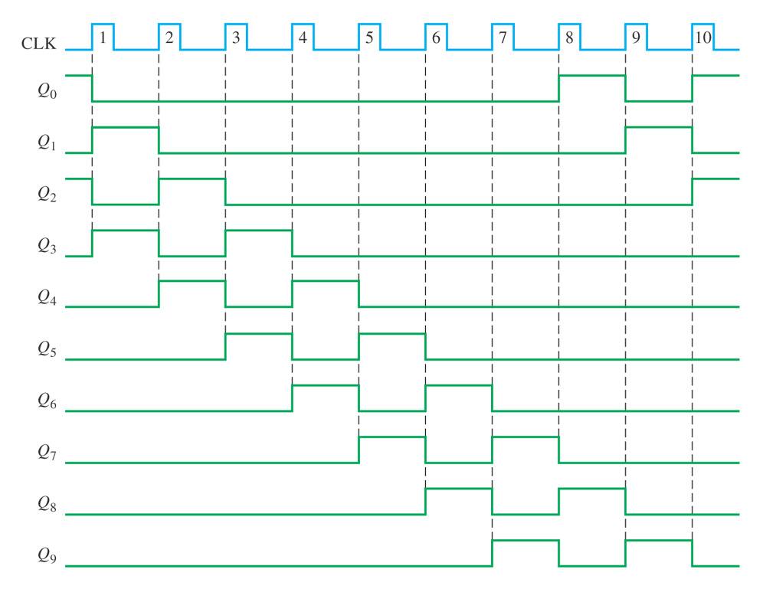
10-bit ring counter has initial state of 1010000000. Find the waveform for each of the Q outputs.
1 0 1 0 0 0 0 0 0 0

Slide 29
Applications
Time Delay – depends on clock frequency and number of clocks
Serial-to Parallel converter
Reduces wires in transmission line
Universal Asynchronous Receiver Transmitter (UART) - Interface with computer
includes serial to parallel converter
parallel to serial converter

Slide 30
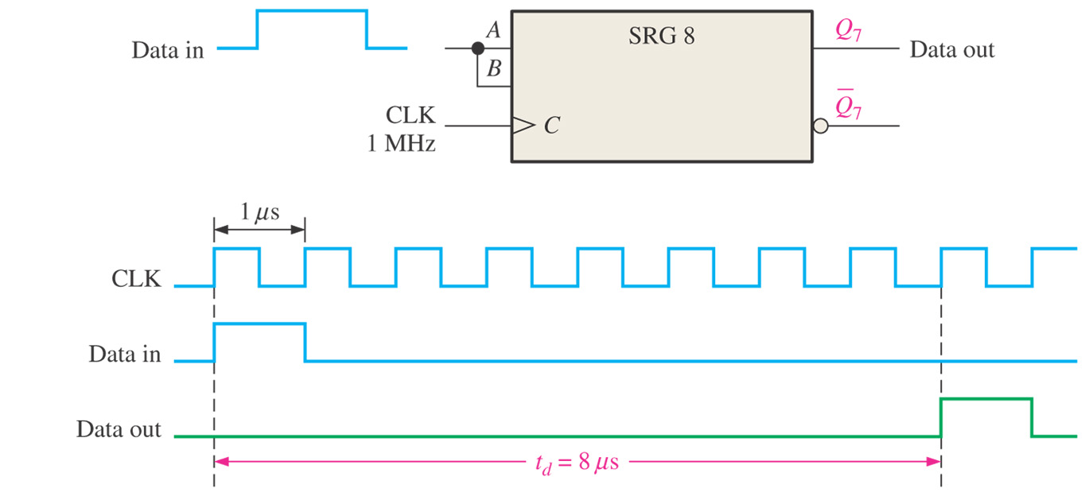
Figure 9–28 The shift register as a time-delay device.

Slide 31
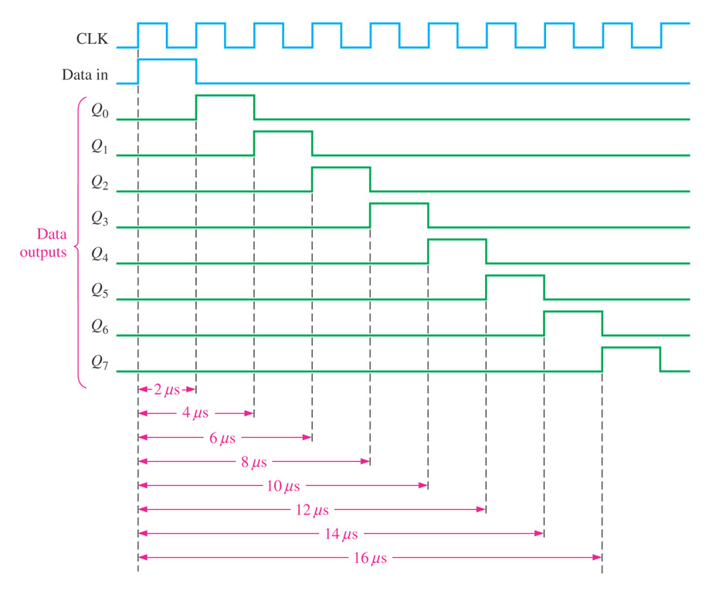
Figure 9–30 Timing diagram showing time delays for the register in Figure 9–29.

Slide 32
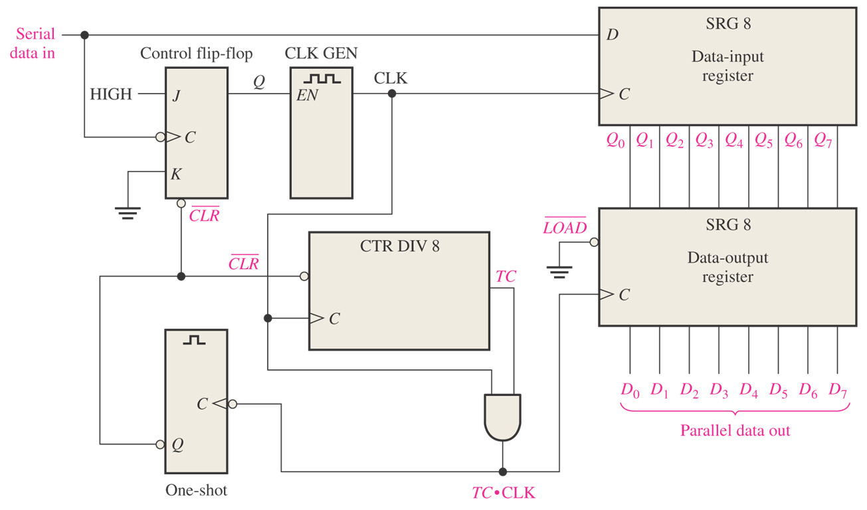
Figure 9–33 Simplified logic diagram of a serial-to-parallel converter.

Slide 33
Figure 9–34 Serial data format.

Slide 34
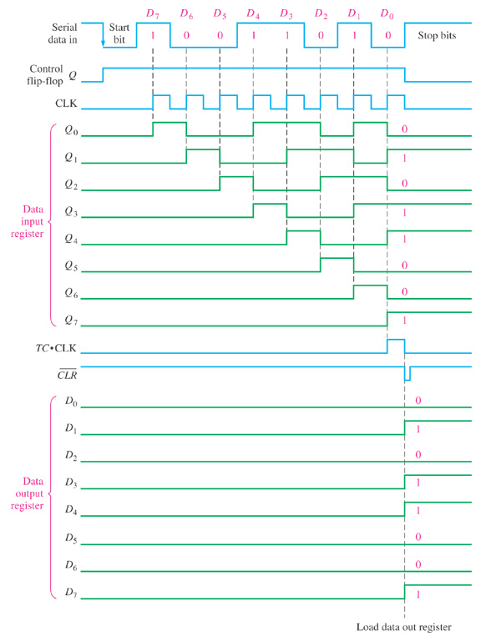
Figure 9–35 Timing diagram illustrating the operation of the serial-to-parallel data converter in Figure 9–33.

Slide 35
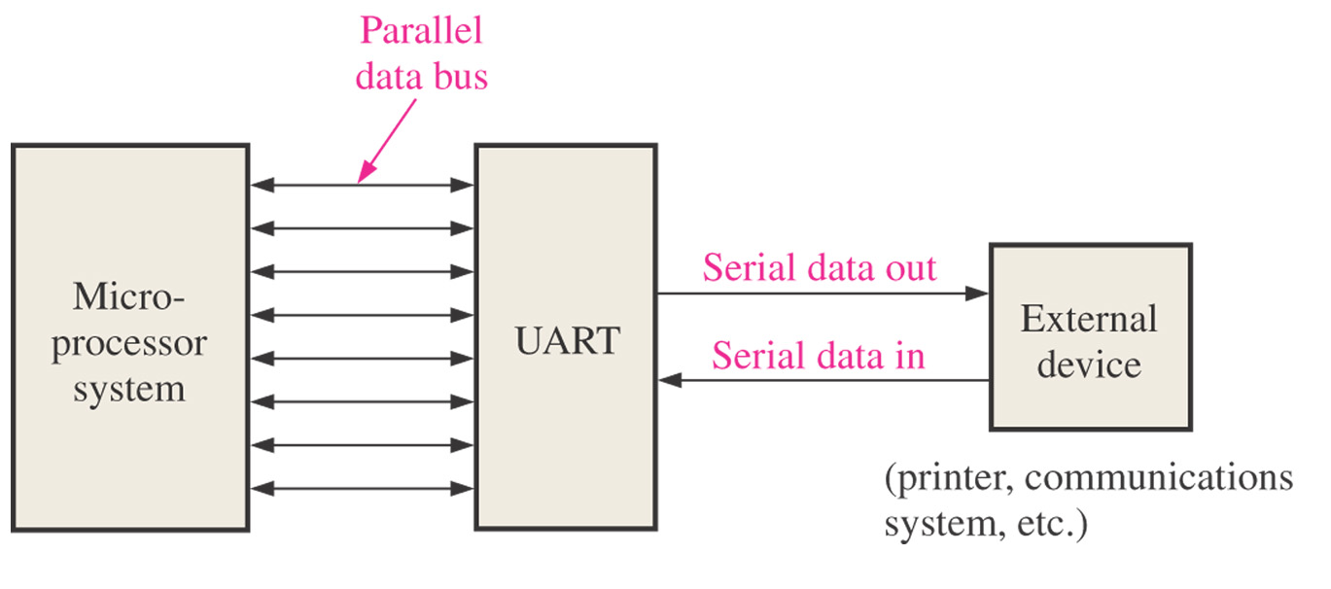
Figure 9–36 UART interface.

Slide 36
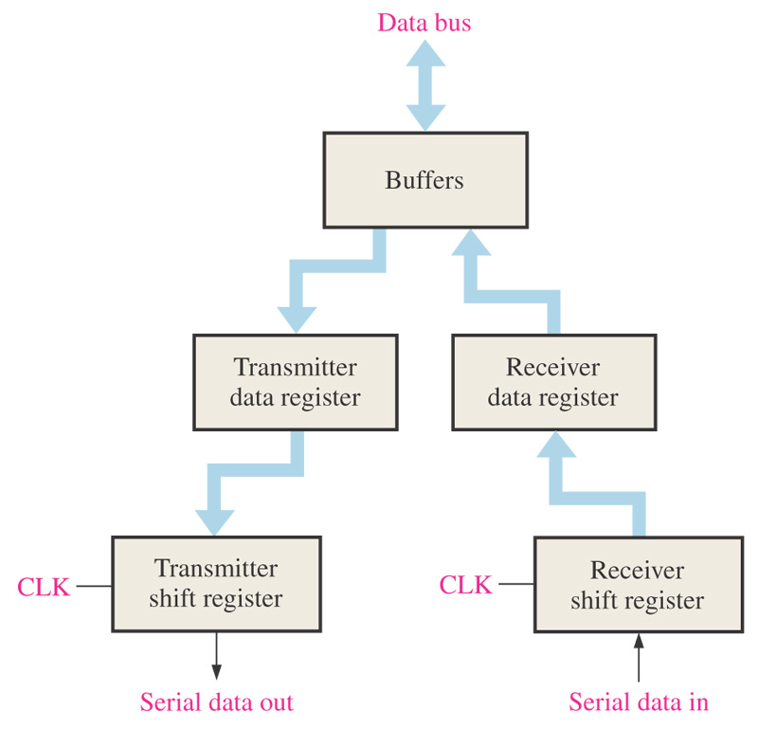
Figure 9–37 Basic UART block diagram.

Slide 37

Figure 9–41 Sample test pattern.

Slide 38
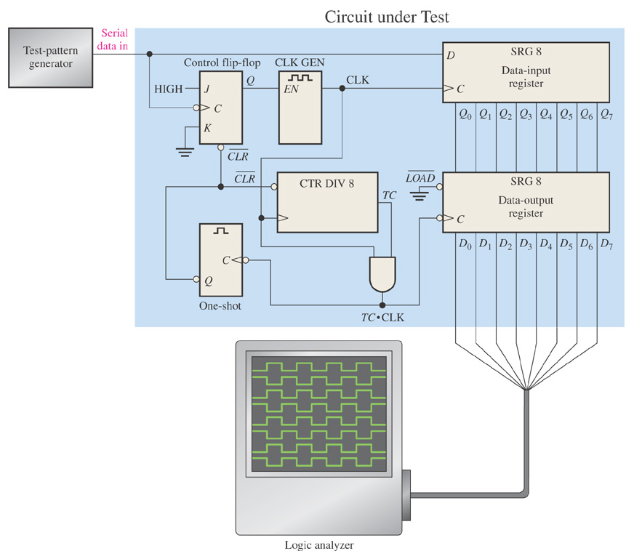
Figure 9–42 Basic test setup for the serial-to-parallel data converter of Figure 9-33.

Slide 39
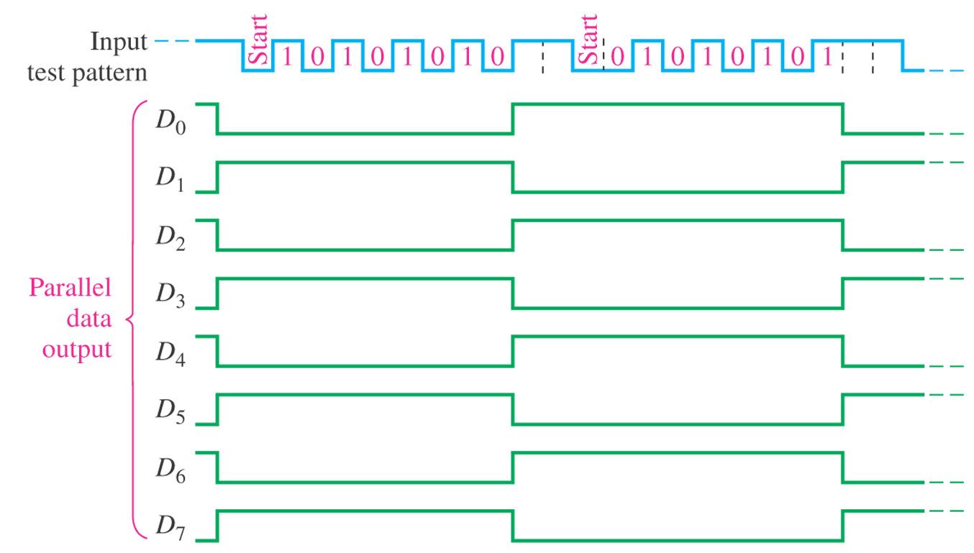
Figure 9–43 Proper outputs for the circuit under test in Figure 9-42. The input test pattern is shown.

Slide 40
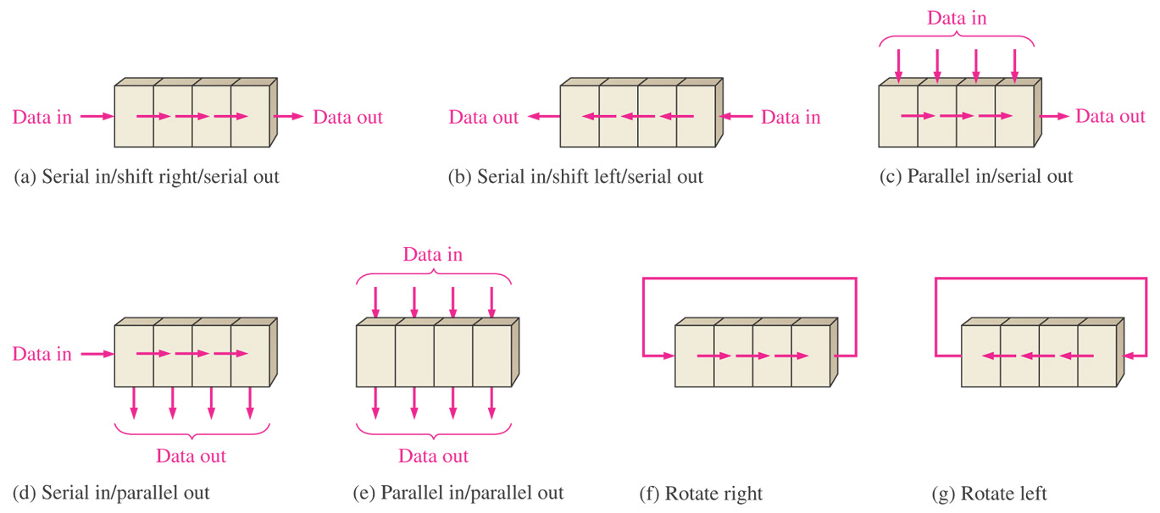
Figure 9–46 Summary of Types of Shift Registers
Bidirectional

Slide 41
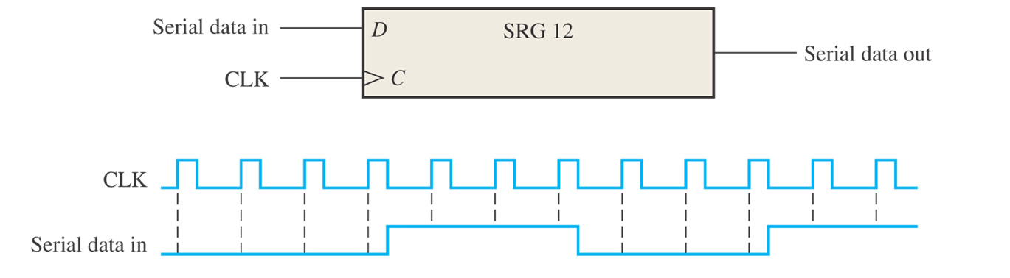
Figure 9–49 Problem 5. What is the state of the register after each clock pulse if it starts in 101001111000 state?

Slide 42
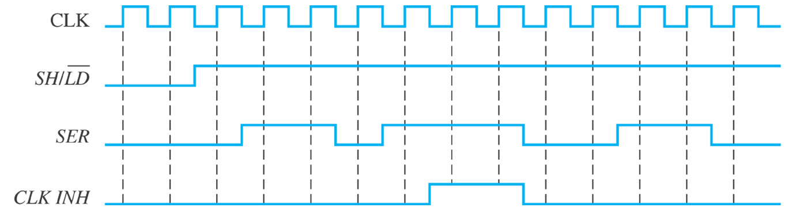
Figure 9–55

Slide 43
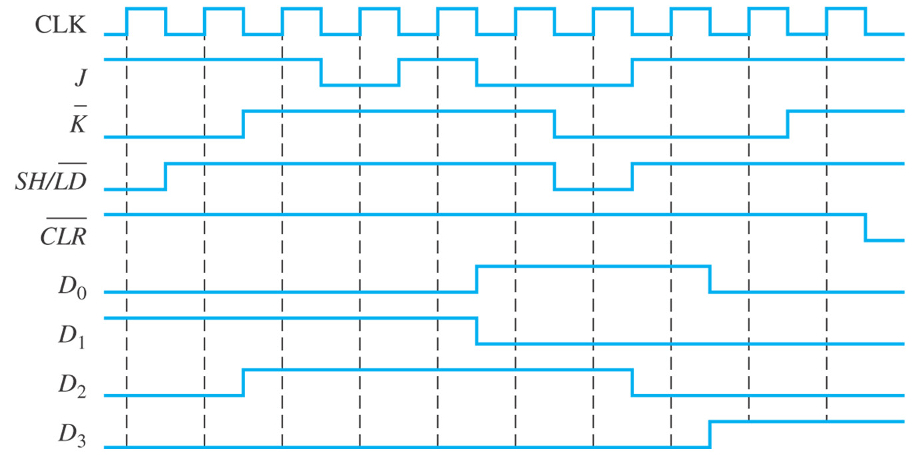
Figure 9–56

Slide 44

Figure 9–57

Slide 45

Figure 9–58

Slide 46

Figure 9–59

Slide 47

Figure 9–60

Slide 48

Figure 9–61

Slide 49

Figure 9–62

Slide 50

Figure 9–63

